Slide 1
Roulette
Bailey Korfhage

Slide 2
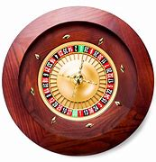
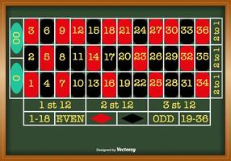
How to play
Roulette is a game of chance that involves betting on 38 numbers or different divisions of the numbers on the board.
You can choose an individual number, one column, one section of dozens, one of the halves, odds or evens, and red or black.
The payout is determined on the odds of the ball landing on the number.
A ball is then spun around the wheel to determine the winning number.

Slide 3
Building Blocks
Class
Random
__init__
self
Function
Print
User input
List
Conditional statements
Global
While loop
Formatted string

Slide 4
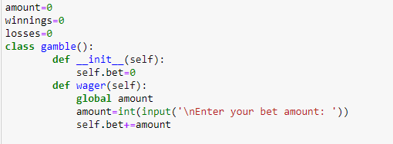
Class
The class sets up the betting and creates a global variable to which each function calls to update winnings and losses.

Slide 5
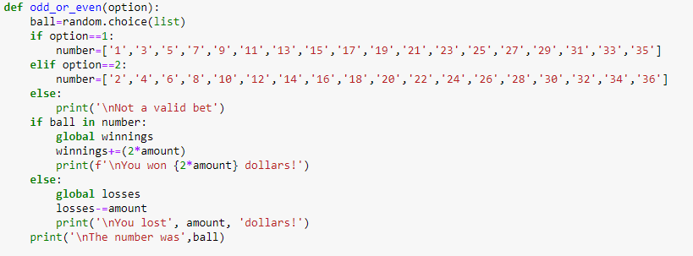
Function
Each function defines a certain option available for betting. It uses an if statement to check if the ball that the game picked matched the player’s pick.

Slide 6
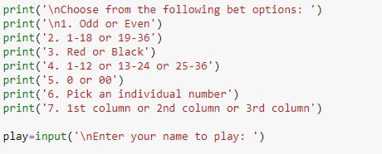
Option set up
Allows the user to choose which type of bet they would like to make.

Slide 7
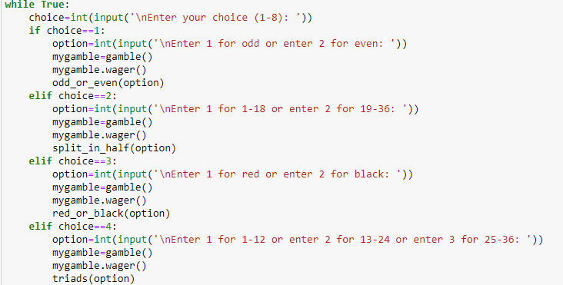
While loop
The while loop allows the code to compare the player input with the option choices. Then it runs the appropriate function.

Slide 8
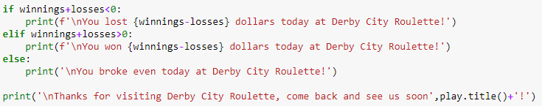
Final print statement
Tells the user if they came out ahead or if they lost money with their bet(s).

